Slide 1
AJAX in MVC .NET
420-C50 S11

Slide 2
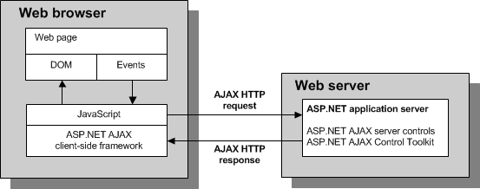
ASP .NET AJAX Architecture
Go beyond plain old AJAX with a deeper software stack
Components
ASP.NET AJAX client-side framework
ASP.NET AJAX server controls
ASP.NET AJAX Control Toolkit

Slide 3
What is it?
From Asp.net web site:
3 frameworks for building websites in ASP.NET
Web Pages – dynamic content with Razor syntax
Web Forms – familiar drag-and-drop, WYSIWYG focused
MVC – powerful pattern with clean separation of concerns
MS is encouraging new projects in MVC4, MVC5 (.NET Framework 4.5)
less code, more control, easier maintenance
easier learning curve to do more sophisticated/custom pages
Migration path
Projects allow mix of Web Forms and MVC
See: http://www.asp.net/get-started/websites
Notes:
http://www.asp.net/get-started/websites
Draw stack: ASP.NET with WebForms, Web pages, MVC on top
http://www.microsoftvirtualacademy.com/training-courses/introduction-to-asp-net-mvc

Slide 4
What is it?
 | If you have experience in | Development Style | Expertise
Web Pages | Classic ASP, PHP | HTML markup and your code together in the same file | New, Mid-Level
Web Forms | Win Forms, WPF, .NET | Rapid development using a rich library of controls that encapsulate HTML markup | Mid-Level, Advanced RAD
MVC | Ruby on Rails, .NET | Full control over HTML markup, code and markup separated, and easy to write tests. The best choice for mobile and single-page applications (SPA). | Mid-Level, Advanced
Notes:
http://www.asp.net/get-started/websites

Slide 5
What is it?
Abstract split between client/server
Automatically generates appropriate client/server code
Ties back to MS legacy of desktop application developers
ASP.net AJAX vs jQuery
jQuery extremely popular, ubiquitous and actively developed
Some programmers are moving to more jQuery-based approach
Uncertainty on MS commitment to long-term ASP.net AJAX as MVC 5 is shifting to more open approach
ASP.NET
Free web framework
Notes:
https://msdn.microsoft.com/library/bb398822.aspx

Slide 6
Plain old AJAX and MVC

Slide 7
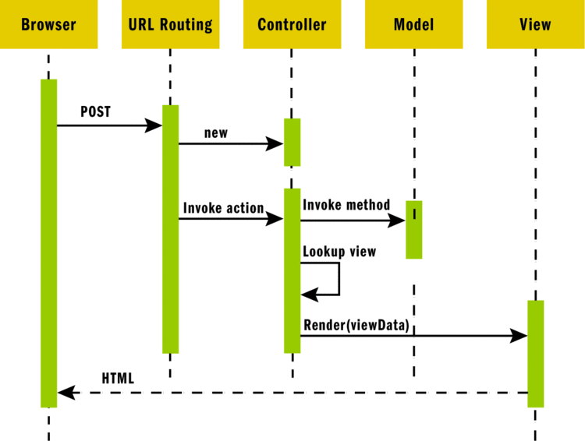
Review: Sequence of MVC Request

Slide 8
AJAX and MVC
MVC
MVC gives us full control of HTML and scripting the view
We get all of that juicy jQuery, Bootstrap CSS (+ other standard JavaScript) goodness
jQuery, Bootstap ships with Visual Studio ASP.NET MVC project template

Slide 9
Controller Actions
Let’s look our controller method from C50 S10
public class HomeController : Controller
{
public ActionResult Index()
{
return View();
}
// remember when Index returned a String?
public ActionResult About()
{
ViewBag.Message = "Your application description page.";
return View();
}
public ActionResult Contact()
{
ViewBag.Message = "Your contact page.";
return View();
}
public ActionResult Boast(int numTimes = 1)
{
ViewBag.Message = "Richard Chan's boast page. " + numTimes + " times";
ViewBag.numTimes = numTimes;
return View();
}
}
Notes:
Note the return type “ActionResult”

Slide 10
AJAX and MVC
How does AJAX with with .NET MVC?
Just want a partial page update
Not a whole view
How to make the MVC model work with AJAX?

Slide 11
Controller Return Types
ActionResult subtypes
ViewResult
PartialViewResult
JsonResult
Notes:
https://msdn.microsoft.com/en-us/library/system.web.mvc.actionresult%28v=vs.118%29.aspx

Slide 12
Controller JsonResult
Returns a serialized Java object!
Not a whole HTTP/web page
Exactly what we want from the server side for AJAX

Slide 13
Controller JsonResult
public JsonResult GetCustomer()
{
Models.Customer customer = new Models.Customer();
customer.CustomerName = "Microsoft";
customer.City = "Redmond";
return Json(customer);
}
Notes:
Key takeaway:
A controller action that we can get to via a URL that returns a JSON object

Slide 14
Client side view
$(document).ready(function() {
$.getJSON("Customer/GetCustomer",null,function(customer){
// got the object, now render!!
alert(customer.CustomerName);
});
});
Notes:
Snippet from view file
note: $get.JSON is just a shorthand variation of $.ajax() (see: http://api.jquery.com/jQuery.getJSON/)
Also note URL routing, controller “Customer”, action “GetCustomer”
Also see: https://msdn.microsoft.com/en-us/library/system.web.mvc.jsonresult(v=vs.118).aspx

Slide 15
Example
Server side in Home controller, action Movies
note Json() and AllowGet
public ActionResult Movies()
{
var movies = new List<object>();
movies.Add(new { Title = "Ghostbusters", Genre = "Comedy", Year = 1984 });
movies.Add(new { Title = "Gone with Wind", Genre = "Drama", Year = 1939 });
movies.Add(new { Title = "Star Wars", Genre = "Science Fiction", Year = 1977 });
return Json(movies, JsonRequestBehavior.AllowGet);
}
Notes:
Snippet from view file
note: $get.JSON is just a shorthand variation of $.ajax() (see: http://api.jquery.com/jQuery.getJSON/)
Also note URL routing, controller “Customer”, action “GetCustomer”
Also see: https://msdn.microsoft.com/en-us/library/system.web.mvc.jsonresult(v=vs.118).aspx

Slide 16
Fetching from the Client side view – URL helper
<input name="btnGetMovies" id="btnGetMovies" type="submit" value="Get Movies">
<ul id="movieList"></ul>
<script src="~/Scripts/jquery-1.10.2.js"></script>
<script type="text/javascript">
$("#btnGetMovies").click(function () {
var actionUrl = '@Url.Action("Movies", "Home")';
$.getJSON(actionUrl, displayData);
});
function displayData(response) {
if (response != null) {
for (var i = 0; i < response.length; i++) {
$("#movieList").append("<li>" + response[i].Title + " " + response[i].Genre + " " + response[i].Year + "</li>")
}
}
}
</script>
Notes:
Snippet from view file
note: $get.JSON is just a shorthand variation of $.ajax() (see: http://api.jquery.com/jQuery.getJSON/)
Also note URL routing, controller “Customer”, action “GetCustomer”
Also see: https://msdn.microsoft.com/en-us/library/system.web.mvc.jsonresult(v=vs.118).aspx

Slide 17
ASP.NET AJAX

Slide 18
ASP .NET AJAX
AJAX helper
Abstract jQuery and AJAX (layered on top)
Automatically generates the JavaScript code that works with the ASP.NET AJAX client-side framework
Specifically: System.Web.Mvc.AjaxHelper
Mode: unobtrusive AJAX
AjaxOptions class to config
Ajax class
Hide javascript from HTML (separate file)
Notes:
https://msdn.microsoft.com/library/bb398822.aspx
https://msdn.microsoft.com/en-us/library/system.web.mvc.ajaxhelper%28v=vs.118%29.aspx
Note, embedded example source code, “Ajax” is also the name of the controller action

Slide 19
Configuring the Request
Ajax Helper allows control of several aspects of request
URL
HTTP Method (GET or POST)
Event Handlers (onBegin, OnComplete, OnSuccess, etc)
LoadingElementID
UpdateTargetID
InsertionMode

Slide 20
AJAX Helper
Nifty features
Progress-type indications (OnBegin)
Abstract some JavaScript from you
You could do this yourself in JavaScript

